Slide 1
GATHER
Opening our worship with scripture & community
Feel free to grab refreshments and read the “overview” on the handout at your seat

Slide 2
And now… for something different

Slide 3
1 Corinthians 12:12-27

Slide 4
Melting Pot vs Hearty Stew
Melting Pot seeks to eliminate uniqueness to create one unified substance
Flavor comes from what remains
Hearty stew allows each element to remain unique
Flavor comes from mixture of different elements AND textures

Slide 5
Melting Pot vs Hearty Stew
The point: Our uniqueness was intentional
1 Peter 4:10
“Each of you should use whatever gift you have received to serve others, as faithful stewards of God’s grace in its various forms”

Slide 6
New Mini-series
We will explore personality traits and differences
We will NOT be trying to figure out a better or worse personality (Luke 18:9-14)
Key question:
HOW CAN KNOWING OUR PERSONALITY TYPE AND HOW IT INTERACTS WITH OTHERS MAKE US MORE LIKE THE CHURCH GOD DESIRES US TO BE?

Slide 7
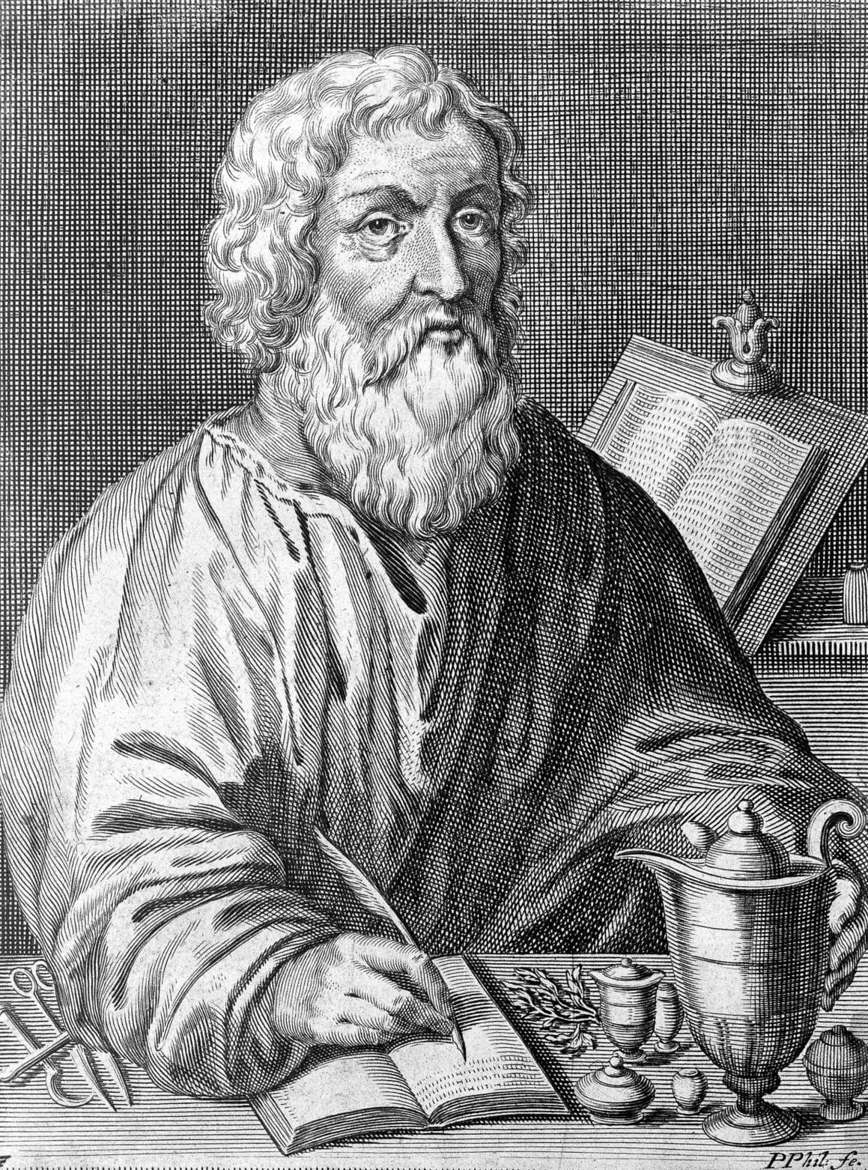
History
Hippocrates
4th century BC
“Hippocratic Oath”
“disease and medical issues NOT punishment by ‘gods’”
Defined Four different types of “human beings” (also known as “temperaments”)

Slide 8
History
Four Temperaments
Sanguine
Choleric
Melancholic
Phlegmatic

Slide 9
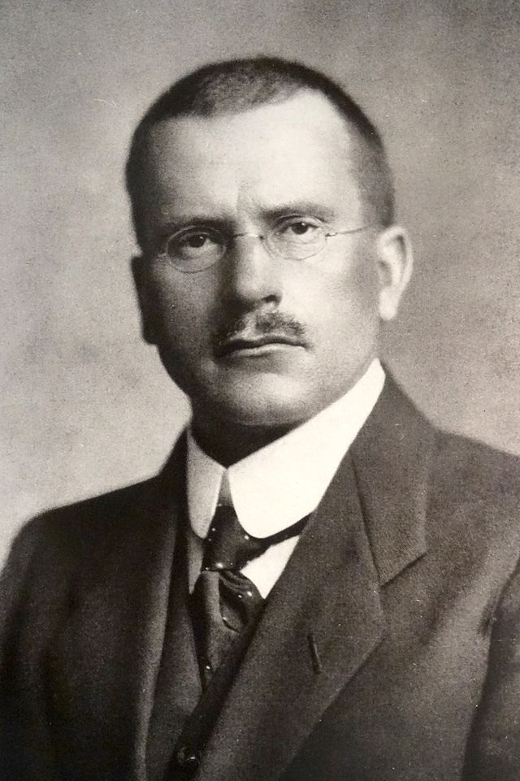
History
Carl Jung
Late 19th/early 20th century
Different “archetypes”
Studied introversion vs extroversion
Developed first official personality assessment

Slide 10
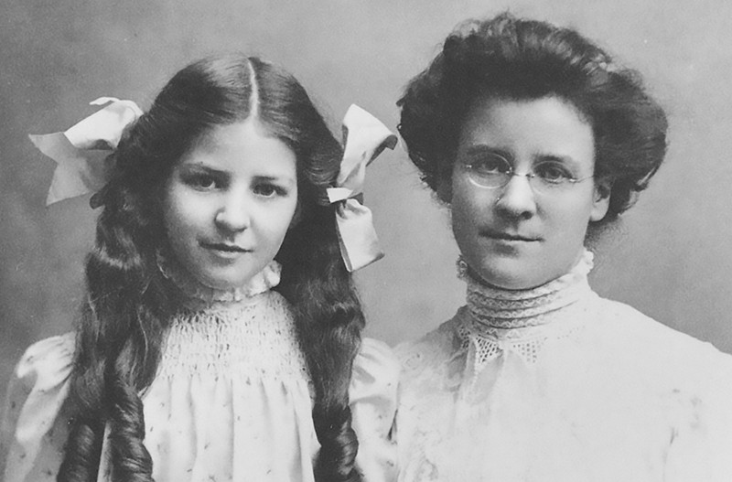
History
Katharine Cook Briggs & Isabel Briggs-Myers
1920’s/1930’s
Developed Carl Jungs theories into the famous MBTI: “Myers-Briggs Type Indicator”

Slide 11
History
David Keirsey
1970’s
Simplified back into 4 primary categories

Slide 12
History
Don Lowry
1978
Developed Jung, Myers Briggs, and Keirsey’s work into the “True Colors” personality assessment.

Slide 13
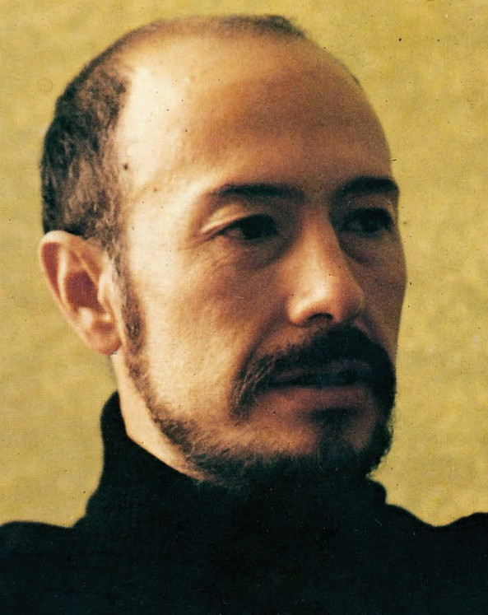
History
Oscar Ichazo
From Bolivia
1930’s
Coined the word “Enneagram”
Geometric figure with 9 points
Developed in 80’s/90’s by several psychologists into 9 primary personality types

Slide 14
Questions as this point?

Slide 16
True Colors: What is it?
True colors is a metaphor, identifying each of the four primary personalities into 4 unique colors: ORANGE, BLUE, GOLD, and GREEN
Each person is a unique blend of the four colors or styles
There are no “Bad” or “Good” colors
There are wide individual variations within each color spectrum

Slide 17
True Colors: What is it?
True Colors is an attempt to identify various personality styles and label them with easy to remember colors.
Created by Don Lowry
His objective was the application of temperament or personality style to facilitate deeper communications and understanding

Slide 18
Our Key Question:
HOW CAN KNOWING OUR PERSONALITY TYPE AND HOW IT INTERACTS WITH OTHERS MAKE US MORE LIKE THE CHURCH GOD DESIRES US TO BE?

Slide 19
True Colors: What is it?
Lowry hoped the study would result in positive self-worth and self esteem
Program was designed to maximize the application of personality styles in the workplace, in the family, in education and in other types of communities.
The belief is that “with increased understanding of ourselves and others, conflict will decrease”

Slide 20
True Colors: What is it?
Each color is associated with certain personality traits and behaviors
Everyone has some degree of each color BUT one color is usually dominant

Slide 21
The Assessment:
ROW 1
A
Active
Variety
Sports
Opportunities
Spontaneous
Flexible
B
Organized
Planned
Neat
Parental
Traditional
Responsible
C
Warm
Helpful
Friends
Authentic
Harmonious
Compassionate
D
Learning
Science
Quiet
Versatile
Inventive
Competent

Slide 22
The Assessment:
ROW 2
E
Curious
Ideas
Questions
Conceptual
Knowledge
Problem Solver
F
Caring
People Oriented
Feelings
Unique
Empathetic
Communicative
G
Orderly
On-Time
Honest
Stable
Sensible
Dependable
H
Action
Challenges
Competitive
Impetuous
Impactful

Slide 23
The Assessment:
ROW 3
I
Helpful
Trustworthy
Dependable
Loyal
Conservative
Organized
J
Kind
Understanding
Giving
Devoted
Warm
Poetic
K
Playful
Quick
Adventurous
Confrontive
Open Minded
Independent
L
Independent
Exploring
Competent
Theoretical
Why Questions
Ingenious

Slide 24
The Assessment:
ROW 4
M
Follow Rules
Useful
Save Money
Concerned
Procedural
Cooperative
N
Active
Free
Winning
Daring
Impulsive
Risk Taker
O
Sharing
Getting Along
Feelings
Tender
Inspirational
Dramatic
P
Thinking
Solving Problems
Perfectionistic
Determined
Complex
Composed

Slide 25
The Assessment:
ROW 5
Q
Puzzles
Seeking Info
Making Sense
Philosophical
Principled
Rational
R
Social Causes
Easy Going
Happy Endings
Approachable
Affectionate
Sympathetic
S
Exciting
Lively
Hands On
Courageous
Skillful
On Stage
T
Pride
Tradition
Do Things Right
Orderly
Conventional
Careful

Slide 26
TOTAL YOUR SCORES
TOTAL ORANGE SCORE
A, H, K, N, S
TOTAL GREEN SCORE
D, E, L, P, Q
TOTAL BLUE SCORE
C, F, J, O, R
TOTAL GOLD SCORE
B, G, I, M, T

Slide 27
BLUE:
Theme:
“Love will keep us together”
Goal:
Wants to appreciate the moment without analysis
Classic line:
“Winning isn’t everything; Harmony is!”
Biggest challenge:
Stating their needs and standing up for themselves

Slide 28
STRENGTHS:
Cares for others
Creative
Flexible
Friendly
Good listener
Honest
Like to laugh… and cry
Loyal
Sincere, genuine
Totally people-oriented
Won’t let others down
Brings joy to others
Compassionate
Sees potential in everyone
Forgiving
Generous
Great hugger
Wants to include everyone
Kind hearted
Loving and romantic
Peacemaker
Sensitive
Team-builder
Trustworthy

Slide 29
STRESSORS:
Worrying about other’s problems
Inability to say no, burnout
Stressed by humorless people
Stressed by criticism or harsh tone/voice
Often feels they haven’t done enough
Attempts to please everyone
Can’t stand argumentative, domineering or cold people
Doesn’t understand people who lack romance or give the silent treatment
Hates menial tasks like paperwork or sticking to deadlines
Conflict equals disharmony

Slide 30
GOLD:
Theme:
“I’ll do it!”
Goal:
Wants to plan and execute
Classic line:
“I know I’m right, it’s either black or white”
Biggest challenge:
Often forces their point of view on others

Slide 31
STRENGTHS:
Accurate and detail-oriented
Clear expectations
Considerate and empathetic
Direct and efficient
Valuing family and friends
Giving and helpful
Consistent and dependable
Loyal
Punctual
Self-motivated
Strong-willed
Open to criticism
Practical
Committed
Decisive and in control
Fair and honest
Focused
Frugal
Organized
Predictable
Responsible and reliable
Self-confident
Stable and structured
Willing to take charge

Slide 32
STRESSORS:
Don’t like being taken advantage of
Uncomfortable with clutter
Can’t stand non-productive meetings, unfinished work, inefficiency, or the lack of clear instructions
Often takes on too much responsibility
Gets easily frustrated from interruptions, last minute changes, or changes in routine
Worry’s too much
Takes on too much
Dislikes having to rely on others

Slide 33
ORANGE:
Theme:
“Where’s the action!”
Goal:
Wants to enjoy the spontaneity of the moment
Classic line:
“Winning isn’t everything; it’s the ONLY thing!”
Biggest challenge:
Sticking to their original agreements and commitments

Slide 34
STRENGTHS:
Active
Artistic
Direct
Spontaneous
Unpredictable
Sense of humor
Impulsive
Exciting
Skillful
Open-minded
Outrageous and vocal
Social
Adventurous
Taking things in stride
Entertaining
Flexible
Generous
Impatient
Just do it! Attitude
Attention seeking
Loyal and caring
Optimistic
People magnet
Risk-taker

Slide 35
STRESSORS:
Aggravated by boredom, lack of action, and slow-moving people
Don’t like fixed rules, being on time, making lists, or attending meetings
Gets frustrated when there is a lack of recognition, when people whine or complain, or when people are too rigid.
Can’t stand paperwork, conformity or needy people.
HATES losing and not being challenged
Doesn’t always stick to political correctness or routines.
Is often uncomfortable sitting still.

Slide 36
GREEN:
Theme:
“Let me think about it”
Goal:
Wants to examine all experiences, so they can be improved next time
Classic line:
“How can I tell you I love you, when I don’t understand it”
Biggest challenge:
Being ready and willing to give in for the good of a relationship, even if it doesn’t make sense

Slide 37
STRENGTHS:
Analytical and Logical
Self-sufficient
Problem solving
Independent and self-directed
Innovative
Asking great questions
Good teacher
Holding high standards
Rational
Self-confident
Skeptical
Trustworthy
Happy to spend time alone
Future-oriented
Honest and direct
Visionaries
Logical & factual
Even-tempered
Well-read
Direct
Witty
Taking nothing for granted

Slide 38
STRESSORS:
Stressed by people who are incompetent, too emotional, or who make quick decisions without thinking
Stressed by having insufficient information, having their personal space violated, or when there are rules that make no sense.
Can’t stand deadlines, inconsistencies, spelling or grammatical errors, interruptions, illogical behavior, redundancy, and dishonesty
Doesn’t like when there is either NO challenge or TOO MUCH challenge
There’s never enough alone-time
Get’s frustrated by pushy people like salesman, and by people who do not value learning
Struggles when they have to rely on others.

