Slide 1
GATHER
Opening our worship with scripture & community
Feel free to grab refreshments and read the “overview” on the handout at your seat

Slide 2
Plan:
Prayer
Recap Last Week
More info on True Colors
Our color’s perspective of the Church
Closing Prayer

Slide 3
Melting Pot vs Hearty Stew
Melting Pot seeks to eliminate uniqueness to create one unified substance
Flavor comes from what remains
Hearty stew allows each element to remain unique
Flavor comes from mixture of different elements AND textures

Slide 4
Melting Pot vs Hearty Stew
Quote: “The creator does not have to imitate or duplicate as does man. God never intended that there should be any duplicates among human beings.” (Taylor G. Bunch)

Slide 5
Melting Pot vs Hearty Stew
Another Quote: “There are no two leaves of a tree precisely alike, neither do all minds run in the same direction. But while this is so, there may be unity in diversity… We are not all fitted to do the same kind of work, but each person’s work is designed by God to help make up His plan.” (Ellen G. White)

Slide 6
KEY QUESTION:
HOW CAN KNOWING OUR PERSONALITY TYPE AND HOW IT INTERACTS WITH OTHERS MAKE US MORE LIKE THE CHURCH GOD DESIRES US TO BE?

Slide 8
True Colors: What is it?C
True colors is a metaphor, identifying each of the four primary personalities into 4 unique colors: ORANGE, BLUE, GOLD, and GREEN
Each person is a unique blend of the four colors or styles
There are no “Bad” or “Good” colors
There are wide individual variations within each color spectrum

Slide 9
Interesting Info
Total of USA Population
BLUE – 16.5%
ORANGE – 27%
Introvert
5.9%
Extrovert
10.6%
Introvert
14.2%
Extrovert
12.8%
Female Population = 19.2%
Male Population = 13.4%
Female Population = 25.4%
Male Population = 28.6%
GREEN – 10.4%
GOLD – 46.4%
Introvert
5.4%
Extrovert
5.0%
Introvert
25.4%
Extrovert
21.0%
Female Population = 5.9%
Male Population = 14.8%
Female Population = 49.5%
Male Population = 43.2%
*Statistics extrapolated from CAPT (Center for Applications of Psychological Type) at:
www.capt.org/mbti-assessment/estimated-frequencies.htm as of April 2015

Slide 10
Interesting Info
True Colors and Meyers-Briggs (MBTI)
ESTJ | ESTP | ENTJ | ENFJ
ESFJ | ESFP | ENTP | ENFP
ISTJ | ISTP | INTJ | INFJ
ISFJ | ISFP | INTP | INFP
ESTJ | ESTP | ENTJ | ENFJ
ESFJ | ESFP | ENTP | ENFP
ISTJ | ISTP | INTJ | INFJ
ISFJ | ISFP | INTP | INFP

Slide 11
Interesting Info
Famous peoples
Fred Rogers, Oprah Winfrey, Michael Jackson, Gandhi, Mohammed Ali, Jimmy Carter, Thomas Jefferson, Mozart, Robin Williams and Jackie Chan
Henry Ford, Margaret Thatcher, George Washington, Florence Nightingale, Mother Teresa, Queen Elizabeth, Denzel Washington and Morgan Freeman
Albert Einstein, Steven Spielberg, Benjamin Franklin, Eleanor Roosevelt, Abraham Lincoln, Leonardo DiCaprio, Katherine Hepburn, and Barbara Walters
Lucille Ball, Elvis Presley, Amelia Earhart, Franklin D. Roosevelt, Winston Churchill, Eddie Murphy, Dwayne “The Rock” Johnson, and Kevin Hart

Slide 12
Interesting Info
People from the Bible
King David, The Apostle Paul, John the Baptist, Job, Jonah, and Lydia
Noah, Abraham, Thomas, Martha, Aaron, and Adam
Moses, King Solomon, Jacob, Joseph (Son of Jacob), Samuel, King Saul
Peter, Samson, Mary Magdalene, Goliath, Rahab, Several of the prophets

Slide 13
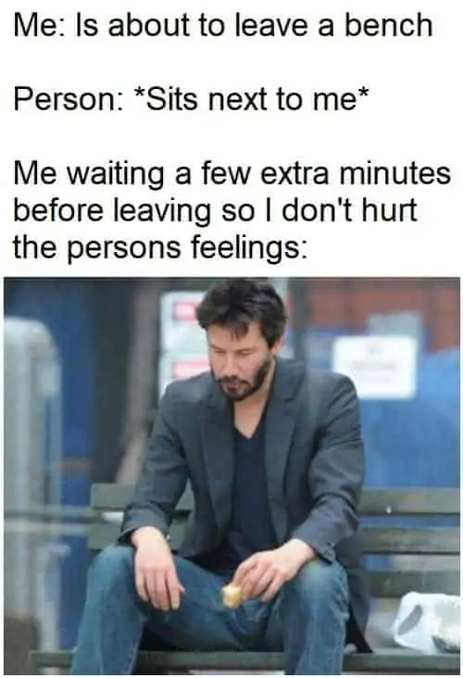
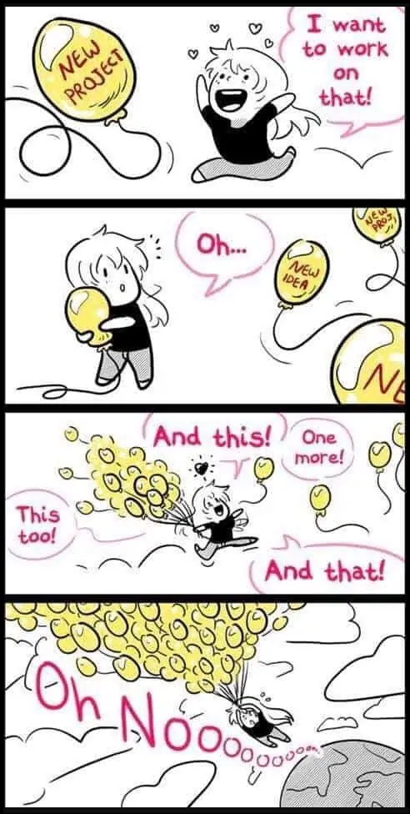
Meme’s to explain BLUE

Slide 14
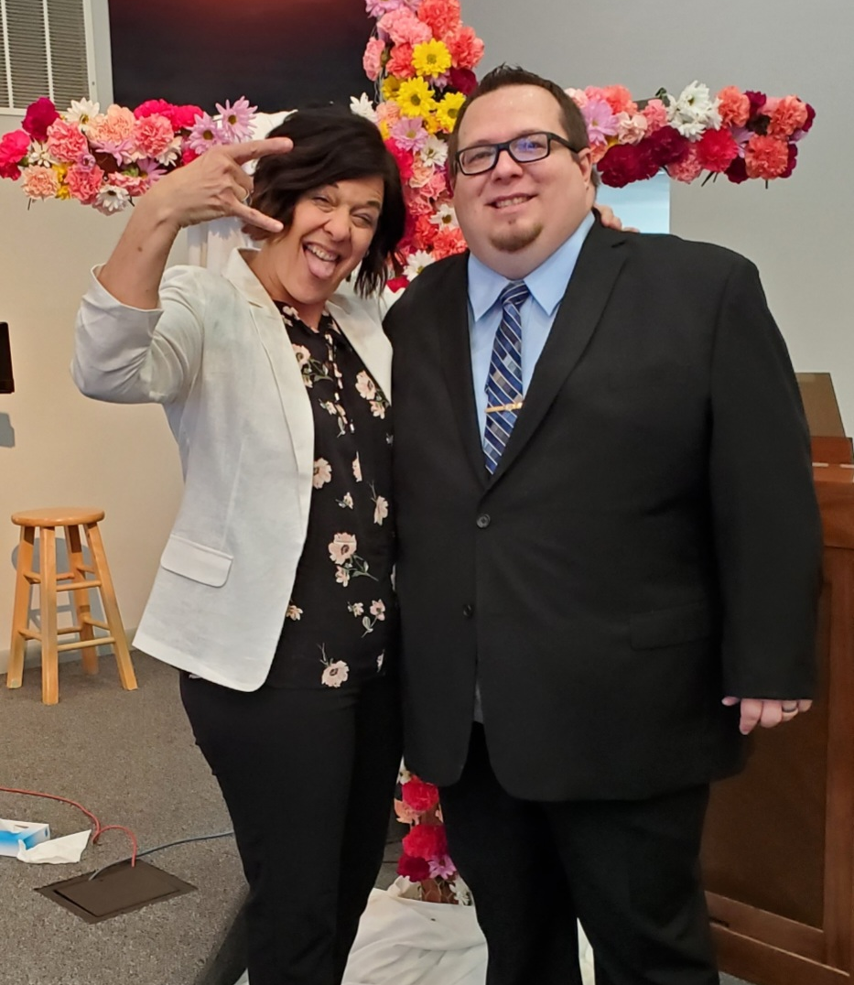
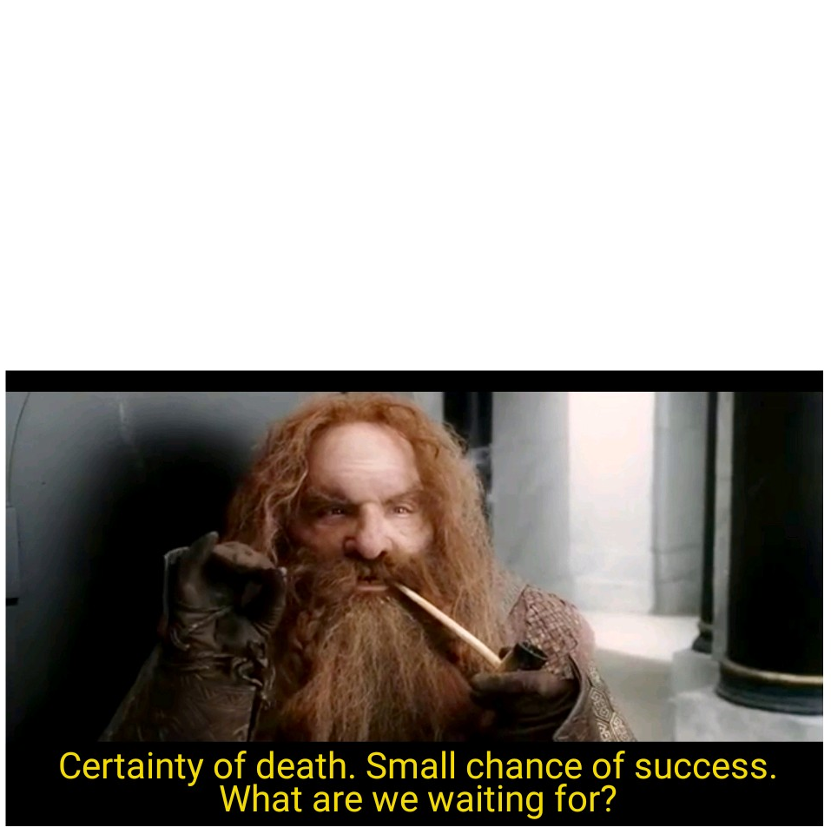
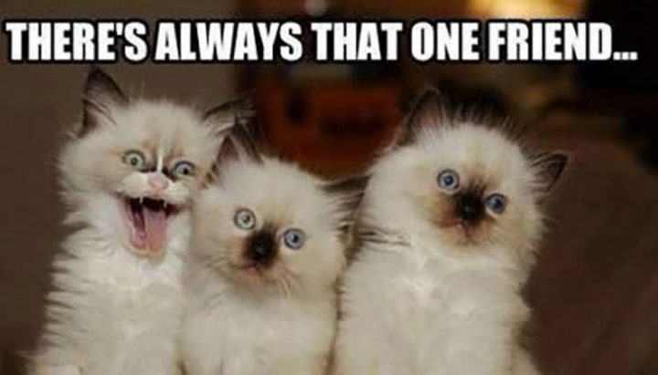
Meme’s to explain ORANGE
People:
Seriously, everyone:
Like… every person you know:
But “Orange’s” be like:

Slide 15
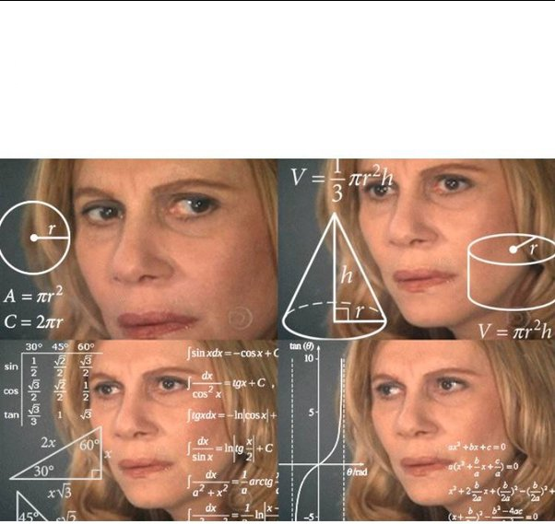
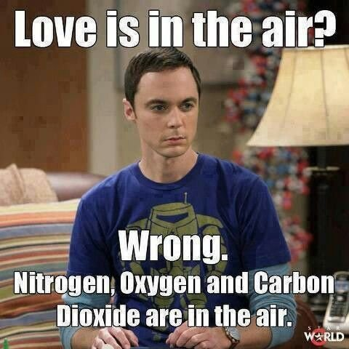
Meme’s to explain GREEN
My Spouse: Lets go on vacation!
Me: (Determining the possibility of going on vacation based on options available, budget, and time, while also trying to ignore the lack of an apostrophe in “Let’s”.)

Slide 16
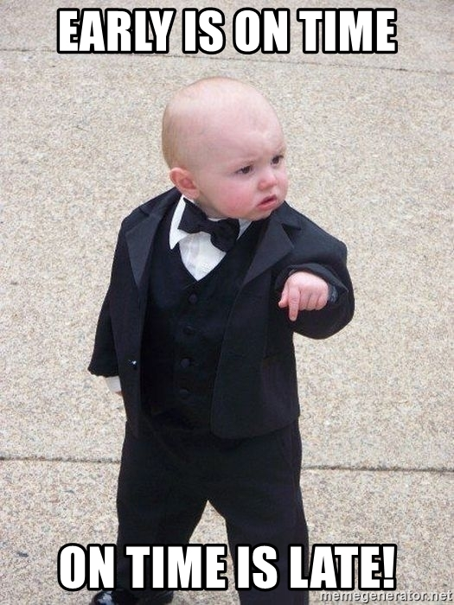
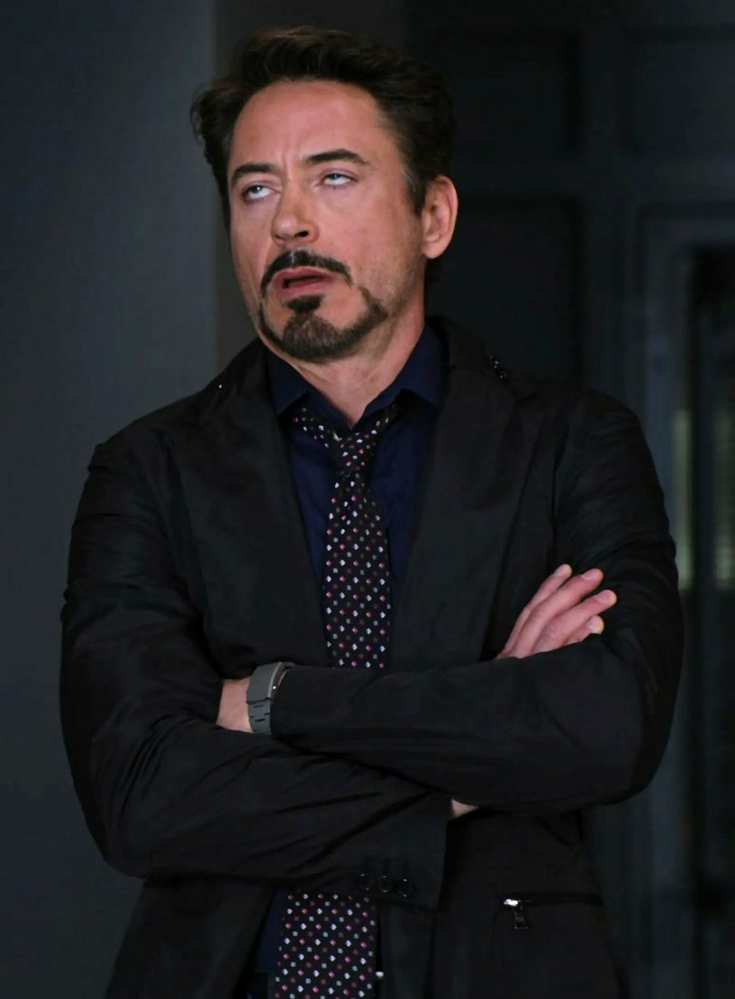
Meme’s to explain GOLD
How I feel about meme’s

Slide 17
Quote from George J. Boelcke, Author of “Colorful Personalities”
“The insights of ‘Colors’ is one-half awareness and one-half choosing to value others for who they are, instead of wanting them to be more like ourselves.”

Slide 18
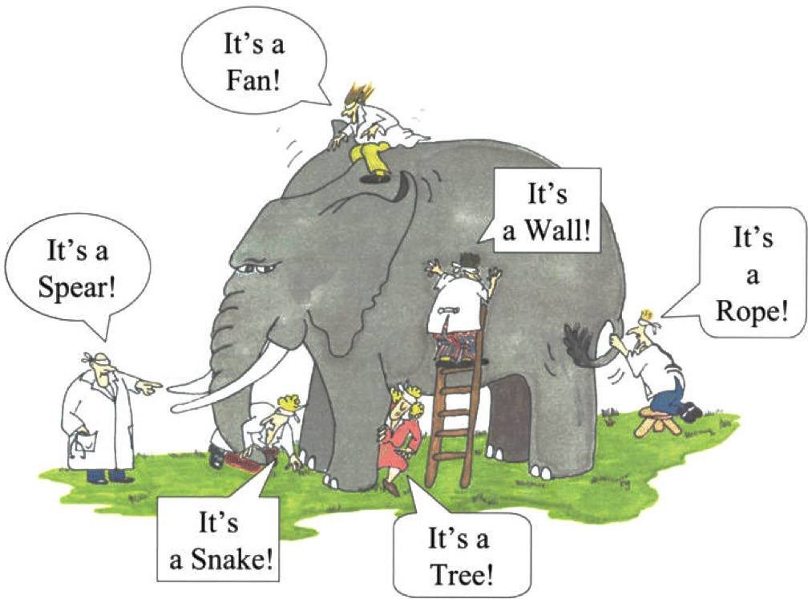
Perspective

Slide 19
BLUE PERSPETIVE:
Others may negatively see them as…
Too nice/pushovers
Bleeding hearts
Not seeing the real world
Easily taken advantage of
Not task-oriented and easily sidetracked
Overly emotional
Smothering
Sugar-coating things
Talking too much
Unrealistic
Affirming of others
Compassionate
Creative
Empathetic
Great Communicators
Idealistic
A people person
Romantic
Trusting
Wanting harmony
Warm & caring
But from their perspective, they are...
* Complete list found in “Life in Colors” by George J. Boelcke

Slide 20
GOLD PERSPETIVE:
Others may negatively see them as…
Bossy
Controlling
Uptight
Dull and boring
Judgmental
Inflexible
Unimaginative
Opinionated
Predictable
Stubborn
Stuck in the system
Abiding by rules
Business-minded
Reliable
Decisive
Efficient
Dependable
Great Planners
Practical and Stable
Realistic
Steady and firm
Very Organized
But from their perspective, they are...
* Complete list found in “Life in Colors” by George J. Boelcke

Slide 21
ORANGE PERSPETIVE:
Others may negatively see them as…
Frequently late
Not serious
Rule-breakers
Scattered
Flaky
Irresponsible
Manipulators
Problem creators
Not trustworthy
Unfeeling or uncaring
Unreliable
Enjoying life
Flexible
Fun-loving
Great negotiators
Focused in the moment
Multi-taskers
Open to ideas/suggestions
Practical
Problem-solvers
Resourceful
Having a winning attitude
But from their perspective, they are...
* Complete list found in “Life in Colors” by George J. Boelcke

Slide 22
GREEN PERSPETIVE:
Others may negatively see them as…
Aloof
Arrogant
Controlled
Uncaring
Fault-finders
Heartless
Intellectual snobs
Lacking mercy
Loners
Unfeeling
Unrealistic
Able to reprimand
Always right
Calm under pressure
Creative
Efficient
Firm-minded
Logical decision-makers
Rational
Justice seekers
Thorough thinkers
Objective
But from their perspective, they are...
* Complete list found in “Life in Colors” by George J. Boelcke

Slide 23
DISCUSSION ACTIVITY:
In your group, come up with a list of three to five aspects or attributes of the “Church” that you value most, based on your “color” type?
(i.e. the types of things that we do as a church, whether it be on Sunday mornings or throughout the week)
(Focus on the “ideal” for your personality type, and not on VECC OR on “what’s best for everyone”)

Slide 24
NEXT WEEK:
We’re going to focus on communication styles and how we can understand and function better alongside different personality types

